Slide 1
Asymmetric
Encryption
(public key)
Confidentiality – message is encrypted with key k and decrypted with key k once at receiver
Integrity – message goes only to specified receiver
Is availability maintained by encryption
Symmetric encryption problem is key distribution, both sender and receiver have same key
Public-Key Cryptography and Message Authentication
Notes:
This chapter provides technical detail on the topics introduced in Sections 2.2
through 2.4 .

Slide 2
RSA Public-Key Encryption
Plain text -> encrypt with KU -> cipher with private key
Problem that you cant be able to derive private key from public key
E for encryption d for decryption
Could use carsons public key to encrypt something and send to him and decrypt with private and he could send message with his private key to be decrypted by his public key
By Rivest, Shamir & Adleman of MIT in 1977
Best known and widely used public-key algorithm
Uses exponentiation of integers modulo a prime
Encrypt: C = Me mod n
Decrypt: M = C^{d} mod n = (Me)^{d} mod n = M
Both sender and receiver know values of n and e
Only receiver knows value of d
Public-key encryption algorithm with public key PU = {e, n} and private key PR = {d, n}
C = M ^ e mod n
Ciphertext = message encrypted
Notes:
Perhaps the most widely used public-key algorithms are RSA and Diffie-Hellman.
One of the first public-key schemes was developed in 1977 by Ron Rivest, Adi Shamir, and Len Adleman at MIT and first published in 1978 [RIVE78]. The RSA scheme has since that time reigned supreme as the most widely accepted and implemented approach to public-key encryption. RSA is a block cipher in which the plaintext and ciphertext are integers between 0 and n – 1 for some n.
Encryption and decryption are of the following form, for some plaintext block M and ciphertext block C:
C = Me mod n
M = C^{d} mod n = (Me)^{d} mod n = M^{ed} mod n
Both sender and receiver must know the values of n and e, and only the receiver knows the value of d. This is a public-key encryption algorithm with a public key of PU = {e, n} and a private key of PR = {d, n}. See text for details of how these values are derived, and their requirements.

Slide 3
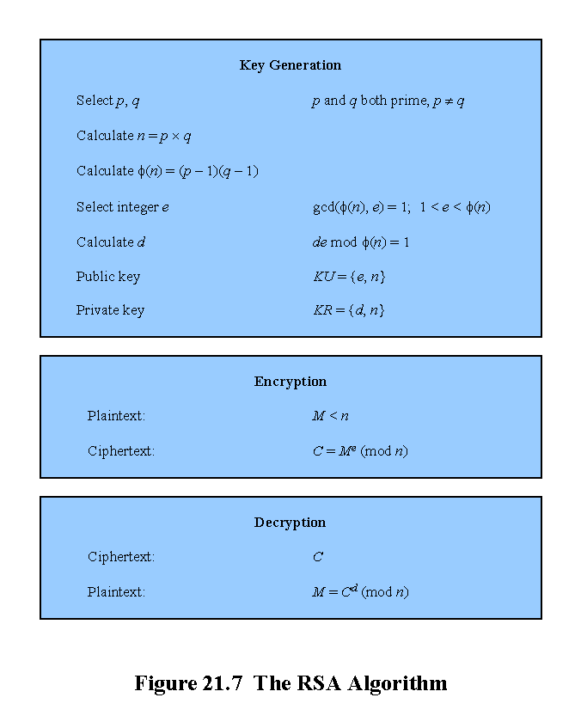
E is prime to n?
Decryption key must be pair with encryption key
Must make sure this is true for pair
If n Is known, that is not a problem it is public, if p and q are known, then encryption is broken
Notes:
Figure 21.7 summarizes the RSA algorithm.

Slide 4
Key generation
P=11
Q=17
ɸ(n) = (P-1)(Q-1) = 10*16 = 160
Pick e S.T gcd(ɸ,e) = 1
Factors for 160 = 1,2,4,5,8,10
Pick 7.
Now find d ST d*e%ɸ==1 (d*7)%160==1
Run program: e==23
Find d: (python)
for i in range(1,100):
a=(7*i)%160;
if (a==1):
print(f'i={i} a={a}')
Can choose other number such as 9

Slide 5
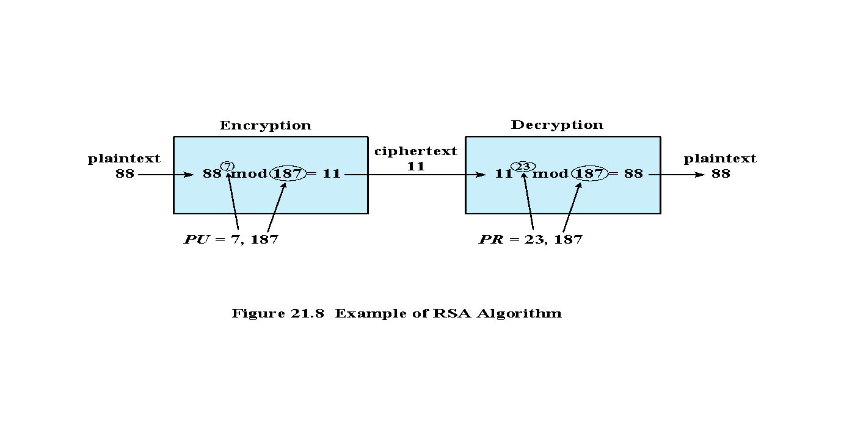
Notes:
An example, from [SING99], is shown in Figure 21.8.

Slide 6
Another example
p=17, q=23
n=391
ɸ (n) = (16*22) = 352
Factors of of 352 = 1,2,4,8,11,16,22,32,44…
Pick 3 as (e)
Run program to find that d= 235
M='o' =111
C = M^E%N = 111^3%391 = 304
M = C^D%N = (304^235)%391 = 111
M='k' = 107
C= (107^3)%391 = 40

Slide 7
Breaking RSA
Given the following public key, break it and find the private key.
PK = 5, 437 (Suman public key, KU)
M = 197,204,40
KU={e,n}={5, 437}
N is product of two prime numbers
N is made of P and Q
Phi (n) = (p-1)(q-1)
Gcd (e, phi, n) = 1
de % 5 = 1
P and q = 19, 23
Phi (n) = 396
Python3 program to calculate Cipher
e=5
n=437
def m(i):
c=pow(i,e,n)
print(c)
m(49)
m(51)
m(53)
1,2,3,4,6,12,18,22,33, 36, 44, 66, 99, 132, 198, 396
(don’t do this one)
5d % 396 = 1
5(2) % 396 = 10
5(3) % 396 = 10
5(33) % 396 = 165
(do this, looking for mod 5)
396 + 1 = 397
396(2) + 1 = 793
396(3) + 1 = 1189
396(4) + 1 = 1585
1585/(5) = 317 = d

Slide 8
Breaking RSA
Given the following public key, break it and find the private key.
PK = 5,437
M = 197,204,40
To break it, factor 437 (1,19,23,437)
ɸ = (p-1)*(q-1) = 18*22 = 396
Now find D = 317 (use program)
197^317%437 = 49 '1'
204^317%437 = 51 '3'
40^317%437 = 53 = '5'
e=5
d=317
n=437
def m(i):
c=pow(i,d,n)
print(c)
m(197)
m(204)
m(40)
this is a python3 program
M to the power d mod n = 53 ASCII I think = 1

Slide 9
Security of RSA
Brute force
Involves trying all possible private keys
Mathematical attacks
There are several approaches, all equivalent in effort to factoring the product of two primes
Timing attacks
These depend on the running time of the decryption algorithm
Chosen ciphertext attacks
This type of attack exploits properties of the RSA algorithm
Notes:
Four possible approaches to attacking the RSA algorithm are:
• Brute force: This involves trying all possible private keys.
• Mathematical attacks: There are several approaches, all equivalent in effort to
factoring the product of two primes.
• Timing attacks: These depend on the running time of the decryption algorithm.
• Chosen ciphertext attacks: This type of attack exploits properties of the RSA algorithm. A discussion of this attack is beyond the scope of this book.

Slide 10
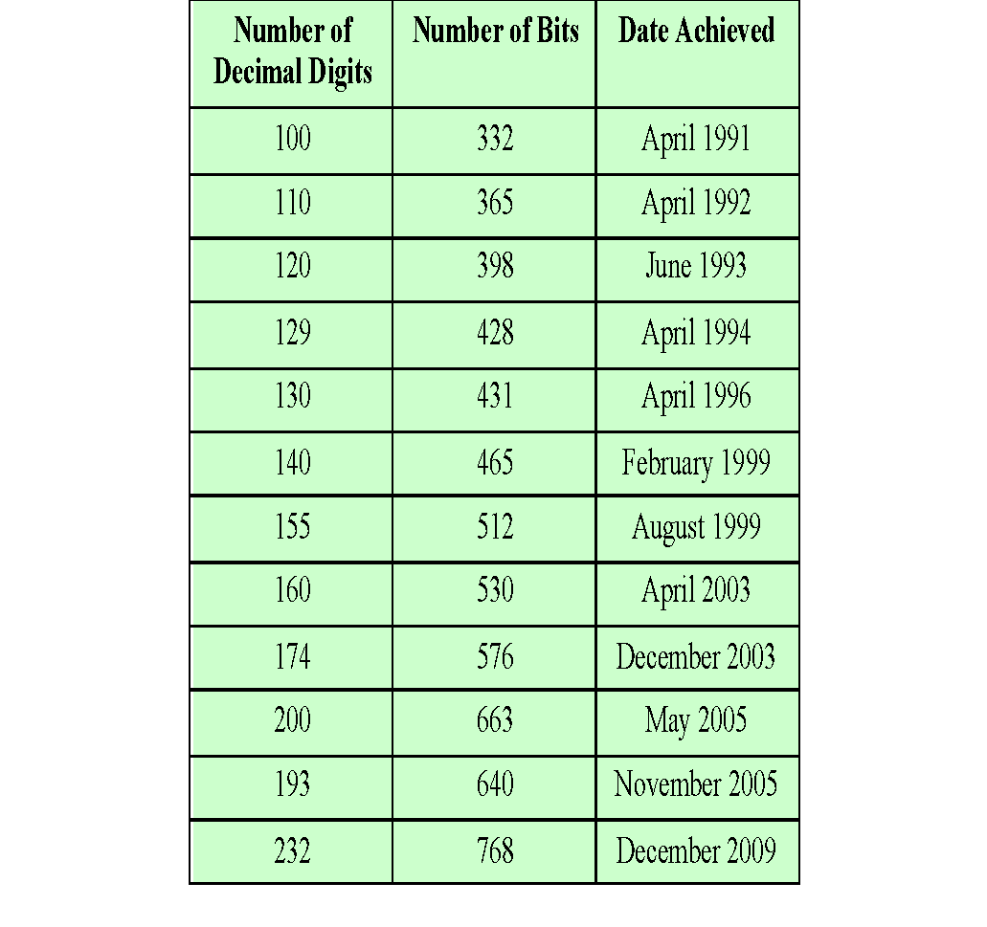
Table 21.2
Progress in Factorization
Notes:
For a large n with large prime factors, factoring is a hard problem, but not
as hard as it used to be. Just as it had done for DES, RSA Laboratories issued
challenges for the RSA cipher with key sizes of 100, 110, 120, and so on, digits. The
latest challenge to be met is the RSA-200 challenge with a key length of 200 decimal
digits, or about 663 bits. Table 21.2 shows the results to date. The level of effort is
measured in MIPS-years: a million-instructions-per-second processor running for
one year, which is about 3 * 10¹³ instructions executed (MIPS-year numbers not
available for last 3 entries).
A striking fact about Table 21.2 concerns the method used. Until the
mid-1990s, factoring attacks were made using an approach known as the quadratic
sieve. The attack on RSA-130 used a newer algorithm, the generalized number field
sieve (GNFS), and was able to factor a larger number than RSA-129 at only 20% of
the computing effort.
The threat to larger key sizes is twofold: the continuing increase in computing
power, and the continuing refinement of factoring algorithms. We have seen
that the move to a different algorithm resulted in a tremendous speedup. We can
expect further refinements in the GNFS, and the use of an even better algorithm is
also a possibility. In fact, a related algorithm, the special number field sieve (SNFS),
can factor numbers with a specialized form considerably faster than the generalized
number field sieve. It is reasonable to expect a breakthrough that would enable
a general factoring performance in about the same time as SNFS, or even better.
Thus, we need to be careful in choosing a key size for RSA. For the near future, a
key size in the range of 1024 to 2048 bits seems secure.
In addition to specifying the size of n , a number of other constraints have been
suggested by researchers. To avoid values of n that may be factored more easily, the
algorithm’s inventors suggest the following constraints on p and q :
1. p and q should differ in length by only a few digits. Thus, for a 1024-bit key
(309 decimal digits), both p and q should be on the order of magnitude of
10 ⁷⁵ to 10 ¹⁰⁰ .
2. Both (p - 1) and (q - 1) should contain a large prime factor.
3. gcd (p - 1, q - 1) should be small.
In addition, it has been demonstrated that if e < n and d < n^{1/4} , then d can be easily
determined [WIEN90].

Slide 11
Timing Attacks
Paul Kocher, a cryptographic consultant, demonstrated that a snooper can determine a private key by keeping track of how long a computer takes to decipher messages
Timing attacks are applicable not just to RSA, but also to other public-key cryptography systems
This attack is alarming for two reasons:
It comes from a completely unexpected direction
It is a ciphertext-only attack
Notes:
If one needed yet another lesson about how difficult it is to assess
the security of a cryptographic algorithm, the appearance of timing attacks provides a
stunning one. Paul Kocher, a cryptographic consultant, demonstrated that a snooper
can determine a private key by keeping track of how long a computer takes to decipher
messages [KOCH96]. Timing attacks are applicable not just to RSA, but also
to other public-key cryptography systems. This attack is alarming for two reasons:
It comes from a completely unexpected direction, and it is a ciphertext-only attack.
A timing attack is somewhat analogous to a burglar guessing the combination
of a safe by observing how long it takes for someone to turn the dial from number to
number. The attack exploits the common use of a modular exponentiation algorithm in
RSA encryption and decryption, but the attack can be adapted to work with any implementation
that does not run in fixed time. In the modular exponentiation algorithm,
exponentiation is accomplished bit by bit, with one modular multiplication performed
at each iteration and an additional modular multiplication performed for each 1 bit.
As Kocher points out in his paper, the attack is simplest to understand in an
extreme case. Suppose the target system uses a modular multiplication function that
is very fast in almost all cases but in a few cases takes much more time than an entire
average modular exponentiation. The attack proceeds bit-by-bit starting with the
leftmost bit, b_{k} .
Therefore, if the observed
time to execute the decryption algorithm is always slow when this particular iteration
is slow with a 1 bit, then this bit is assumed to be 1. If a number of observed execution
times for the entire algorithm are fast, then this bit is assumed to be 0.
In practice, modular exponentiation implementations do not have such extreme
timing variations, in which the execution time of a single iteration can exceed the
mean execution time of the entire algorithm. Nevertheless, there is enough variation
to make this attack practical. For details, see [KOCH96].

Slide 12
Timing Attack Countermeasures
Constant exponentiation time
Random delay
Blinding
Ensure that all exponentiations take the same amount of time before returning a result
This is a simple fix but does degrade performance
Better performance could be achieved by adding a random delay to the exponentiation algorithm to confuse the timing attack
If defenders do not add enough noise, attackers could still succeed by collecting additional measurements to compensate for the random delays
Multiply the ciphertext by a random number before performing exponentiation
This process prevents the attacker from knowing what ciphertext bits are being processed inside the computer and therefore prevents the bit-by-bit analysis essential to the timing attack
Notes:
• Constant exponentiation time: Ensure that all exponentiations take the same
amount of time before returning a result. This is a simple fix but does degrade
performance.
• Random delay: Better performance could be achieved by adding a random delay
to the exponentiation algorithm to confuse the timing attack. Kocher points out
that if defenders do not add enough noise, attackers could still succeed by collecting
additional measurements to compensate for the random delays.
• Blinding: Multiply the ciphertext by a random number before performing
exponentiation. This process prevents the attacker from knowing what ciphertext
bits are being processed inside the computer and therefore prevents the
bit-by-bit analysis essential to the timing attack.

Slide 13
Diffie-Hellman Key Exchange
First published public-key algorithm
By Diffie and Hellman in 1976 along with the exposition of public key concepts
Used in a number of commercial products
Practical method to exchange a secret key securely that can then be used for subsequent encryption of messages
Security relies on difficulty of computing discrete logarithms
Notes:
The first published public-key algorithm appeared in the seminal paper by Diffie
and Hellman that defined public-key cryptography [DIFF76] and is generally
referred to as Diffie-Hellman key exchange. A number of commercial products
employ this key exchange technique.
The purpose of the algorithm is to enable two users to exchange a secret key
securely that can then be used for subsequent encryption of messages. The algorithm
itself is limited to the exchange of the keys.
The Diffie-Hellman algorithm depends for its effectiveness on the difficulty of
computing discrete logarithms.

Slide 14
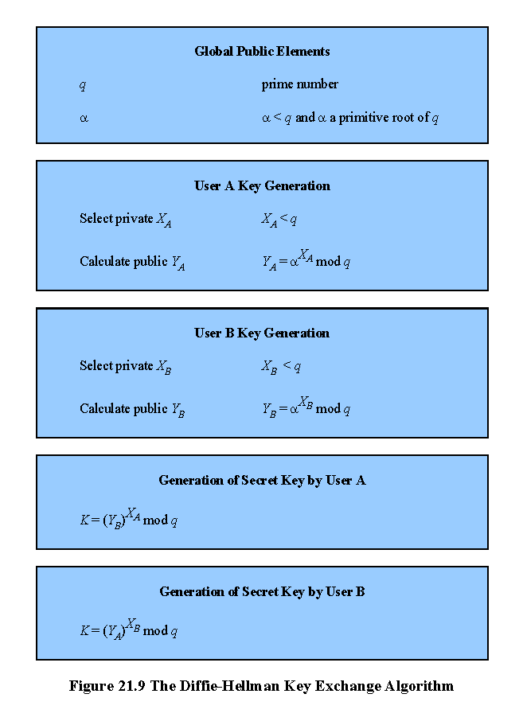
Prime
Primitive root (he’ll give it to us)
Key generation
Secret key
Notes:
The Diffie-Hellman key exchange algorithm is summarized in Figure 21.9. For this scheme, there are two publicly known numbers: a prime number q and an integer α that is a primitive root of q. Suppose the users A and B wish to exchange a key. User A selects a random integer X_{A} < q and computes . Similarly, user B independently selects a random integer X_{B} < q and computes . Each side keeps the X value private and makes the Y value available publicly to the other side. Users A and B compute the key as shown. These two calculations produce identical results, as shown in the text. The result is that the two sides have exchanged a secret value.
Furthermore, because X_{A} and X_{B} are private, an adversary only has the following ingredients to work with: q, α, Y_{A}, and Y_{B}. Thus, the adversary is forced to take a discrete logarithm to determine the key. For example, to determine the private key of user B, an adversary must compute: X_{B} = dlog_{α,q}(Y_{B}). The adversary can then calculate the key K in the same manner as user B calculates it.
The security of the Diffie-Hellman key exchange lies in the fact that, while it is relatively easy to calculate exponentials modulo a prime, it is very difficult to calculate discrete logarithms. For large primes, the latter task is considered infeasible.

Slide 15
What is primitive root?
Read from Wikipedia and Briliant.org
Please explain it to your peers
q-prime numbers
Alpha – primitive root of q
X = count up
X | 2^x % q
0 | 1
| 2
| 4
| 8
| 5
| 10
| 9
| 7
| 3
| 6
| 1

Slide 16
Diffie-Hellman Example
Have
Prime number q = 353
Primitive root α = 3
A and B each compute their public keys
A computes Y_{A} = 3⁹⁷ mod 353 = 40
B computes Y_{B} = 3²³³ mod 353 = 248
Then exchange and compute secret key:
For A: K = (Y_{B})^{XA} mod 353 = 248⁹⁷ mod 353 = 160
For B: K = (Y_{A})^{XB} mod 353 = 40²³³ mod 353 = 160
Attacker must solve:
3ª mod 353 = 40 which is hard
Desired answer is 97, then compute key as B does
Notes:
The security of the Diffie-Hellman key exchange lies in the fact that, while it
is relatively easy to calculate exponentials modulo a prime, it is very difficult to calculate
discrete logarithms. For large primes, the latter task is considered infeasible
Here is an example. Key exchange is based on the use of the prime number q = 353 and a primitive root of 353, in this case α = 3. A and B select secret keys X_{A} = 97 and X_{B} = 233, respectively. Each computes its public key:
A computes Y_{A} = 3⁹⁷ mod 353 = 40.
B computes Y_{B} = 3²³³ mod 353 = 248.
After they exchange public keys, each can compute the common secret key:
A computes K = (Y_{B})^{XA} mod 353 = 248⁹⁷ mod 353 = 160.
B computes K = (Y_{A})^{XB} mod 353 = 40²³³ mod 353 = 160.
We assume an attacker would have available the following information:
q = 353; α = 3; Y_{A} = 40; Y_{B} = 248
In this simple example, it would be possible by brute force to determine the secret key 160. In particular, an attacker E can determine the common key by discovering a solution to the equation 3ª mod 353 = 40 or the equation 3^{b} mod 353 = 248. The brute-force approach is to calculate powers of 3 modulo 353, stopping when the result equals either 40 or 248. The desired answer is reached with the exponent value of 97, which provides 3⁹⁷ mod 353 = 40.
With larger numbers, the problem becomes impractical.

Slide 17
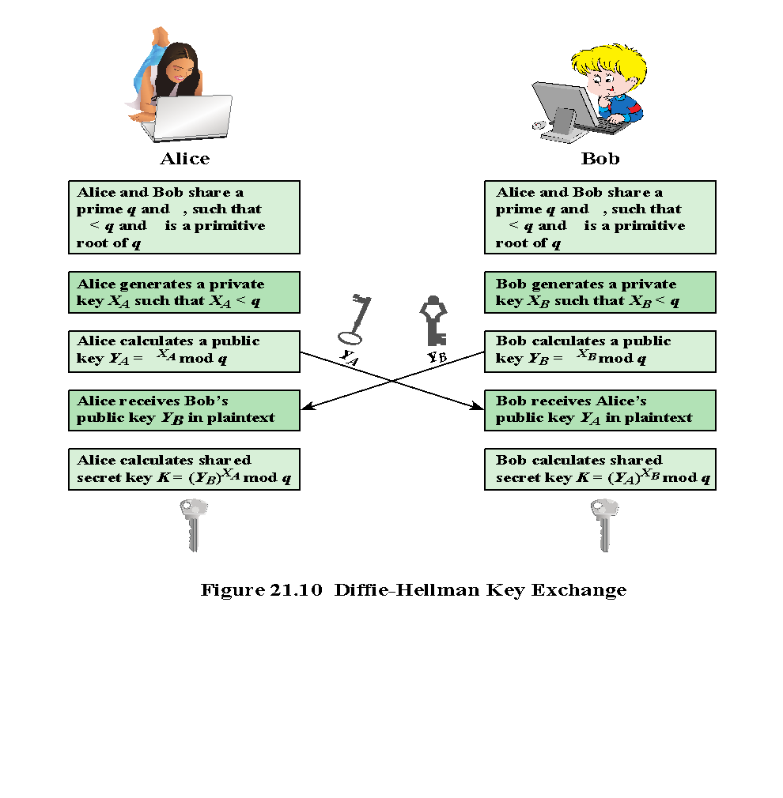
Notes:
Figure 21.10 shows a simple protocol that makes use of the Diffie-Hellman calculation. Suppose that user A wishes to set up a connection with user B and use a secret key to encrypt messages on that connection. User A can generate a one-time private key X_{A}, calculate Y_{A}, and send that to user B. User B responds by generating a private value X_{B}, calculating Y_{B}, and sending Y_{B} to user A. Both users can now calculate the key. The necessary public values q and α would need to be known ahead of time. Alternatively, user A could pick values for q and α and include those in the first message.
As an example of another use of the Diffie-Hellman algorithm, suppose that a group of users (e.g., all users on a LAN) each generate a long-lasting private value X_{A} and calculate a public value Y_{A}. These public values, together with global public values for q and α, are stored in some central directory. At any time, user B can access user A's public value, calculate a secret key, and use that to send an encrypted message to user A. If the central directory is trusted, then this form of communication provides both confidentiality and a degree of authentication. Because only A and B can determine the key, no other user can read the message (confidentiality). Recipient A knows that only user B could have created a message using this key (authentication). However, the technique does not protect against replay attacks.

Slide 18
Man-in-the-Middle Attack
Attack is:
Darth generates private keys X_{D1} and X_{D2}, and their public keys Y_{D1} and Y_{D2}
Alice transmits Y_{A} to Bob
Darth intercepts Y_{A} and transmits Y_{D1} to Bob. Darth also calculates K2
Bob receives Y_{D1} and calculates K1
Bob transmits X_{A} to Alice
Darth intercepts X_{A} and transmits Y_{D2} to Alice. Darth calculates K1
Alice receives Y_{D2} and calculates K2
All subsequent communications compromised
Notes:
The protocol depicted in Figure 21.10 is insecure against a man-in-the-middle attack. Suppose Alice and Bob wish to exchange keys, and Darth is attacks as follows:
1. Darth generates two private keys X_{D1} and X_{D2}, and public keys Y_{D1} & Y_{D2}.
2. Alice transmits Y_{A} to Bob.
3. Darth intercepts Y_{A} and transmits Y_{D1} to Bob. Darth also calculates K2
4. Bob receives Y_{D1} and calculates K1.
5. Bob transmits X_{A} to Alice.
6. Darth intercepts X_{A} and transmits Y_{D2} to Alice. Darth calculates .
7. Alice receives Y_{D2} and calculates .
At this point, Bob and Alice think that they share a secret key, but instead Bob and Darth share secret key K1 and Alice and Darth share secret key K2. All future communication between Bob and Alice is compromised in the following way:
1. Alice sends an encrypted message M: E(K2, M).
2. Darth intercepts the encrypted message and decrypts it, to recover M.
3. Darth sends Bob E(K1, M) or E(K1, M'), where M' is any message. In the first case, Darth simply wants to eavesdrop on the communication without altering it. In the second case, Darth wants to modify the message going to Bob.
The key exchange protocol is vulnerable to such an attack because it does not authenticate the participants. This vulnerability can be overcome with the use of digital signatures and public-key certificates.

Slide 19
Other Public-Key Algorithms
Digital Signature
Standard (DSS)
Elliptic-Curve Cryptography (ECC)
FIPS PUB 186
Makes use of SHA-1 and the Digital Signature Algorithm (DSA)
Originally proposed in 1991, revised in 1993 due to security concerns, and another minor revision in 1996
Cannot be used for encryption or key exchange
Uses an algorithm that is designed to provide only the digital signature function
Equal security for smaller bit size than RSA
Seen in standards such as IEEE P1363
Confidence level in ECC is not yet as high as that in RSA
Based on a mathematical construct known as the elliptic curve
Notes:
The National Institute of Standards and Technology
(NIST) has published this as Federal Information Processing Standard FIPS 186-4
[Digital Signature Standard (DSS), July 2013]. The DSS makes use of the SHA-1 and
presents a new digital signature technique, the Digital Signature Algorithm (DSA).
The DSS was originally proposed in 1991 and revised in 1993 in response to public
feedback concerning the security of the scheme. There were further minor revisions in
1996 and 2013. The DSS uses an algorithm that is designed to provide only the digital
signature function. Unlike RSA, it cannot be used for encryption or key exchange.
The vast majority of the products and standards
that use public-key cryptography for encryption and digital signatures use RSA. The
bit length for secure RSA use has increased over recent years, and this has put a
heavier processing load on applications using RSA. This burden has ramifications,
especially for electronic commerce sites that conduct large numbers of secure transactions.
Recently, a competing system has begun to challenge RSA: elliptic curve
cryptography (ECC). Already, ECC is showing up in standardization efforts, including
the IEEE P1363 Standard for Public-Key Cryptography. A version of ECC used for
digital signature is included as an option in FIPS 186-4.
The principal attraction of ECC compared to RSA is that it appears to offer equal security for a far smaller bit size, thereby reducing processing overhead. On the other hand, although the theory of ECC has been around for some time, it is only recently that products have begun to appear and that there has been sustained cryptanalytic interest in probing for weaknesses. Thus, the confidence level in ECC is not yet as high as that in RSA.
ECC is fundamentally more difficult to explain, and a full mathematical description is beyond the scope of this book. The technique is based on the use of a mathematical construct known as the elliptic curve.

Slide 20
ssh ras
campbest@ceclnx01:~$ openssl rsa -in test2 -noout -text
RSA Private-Key: (3072 bit, 2 primes)
modulus:
00:b9:fc:0f:b2:cc:19:f8:31:f4:14:5a:ab:dd:55:
34:bb:89:90:a7:ef:d8:4c:b6:d9:2b:42:4e:83:d4:
24:eb:e1:a2:63:b1:9e:aa:08:a1:66:3c:7d:f7:c8:
7e:0c:60:26:50:9f:42:8a:d7:2c:95:f7:8d:3f:53:
50:1f:5d:7b:a9:c6:33:e9:1b:c6:eb:68:05:62:32:
f8:02:66:16:4c:ec:1e:43:1a:cf:14:18:78:ab:d3:
61:3b:00:c8:16:02:8c:2a:cb:65:20:b2:d0:bd:b9:
20:e8:66:61:51:b4:bd:c5:3f:6f:23:47:07:c8:a7:
ed:0e:77:16:9f:3d:4f:4a:86:36:49:42:b2:93:cc:
6e:c0:45:63:fe:a1:ce:06:74:94:07:bd:6e:8b:17:
4a:86:02:40:e2:a2:fe:6b:79:09:04:a8:9b:96:c7:
d1:ad:4c:e8:d0:be:23:3c:8d:10:ee:bb:0a:3d:c6:
d5:d6:a0:d4:95:ac:21:85:99:16:09:5d:a7:80:6a:
f2:68:53:72:30:0a:8d:4f:47:a5:5d:72:67:94:32:
38:e9:89:ac:4e:b3:63:12:3a:df:2e:d8:00:42:d0:
41:55:05:0f:a9:f2:27:21:86:2f:b2:64:41:11:b2:
d2:b4:24:43:e2:14:9e:45:ab:f0:80:3b:25:ad:4e:
7f:83:cb:85:59:75:14:80:45:a8:6a:24:75:ee:9a:
a1:39:32:f5:fb:59:d1:5b:45:44:21:86:8b:2f:84:
36:b3:80:be:8d:80:ac:55:4f:8e:93:44:9a:ca:ee:
99:a1:f5:bf:12:5f:40:ff:57:3f:bf:eb:d1:33:fe:
6c:29:8a:eb:f6:60:62:e6:6d:cd:c1:5b:cc:f9:b4:
a0:81:31:07:1b:17:49:53:41:13:f8:7d:ab:fc:c2:
15:c9:9a:28:8b:18:ea:e0:39:7a:06:7d:b3:77:77:
b7:e6:95:19:03:a0:27:a0:42:55:d1:b6:8d:7b:22:
82:2d:26:e0:19:45:95:ed:58:e7
publicExponent: 65537 (0x10001)
privateExponent:
5a:d8:70:a2:99:67:a6:00:60:85:00:b5:2a:6b:d0:
52:3a:a3:da:24:21:b7:77:29:25:24:42:4d:ca:76:
2e:72:0c:6c:3d:fa:8e:7b:a0:ba:db:99:7c:4b:06:
a6:ec:e0:4a:49:40:ab:a8:e7:32:69:b5:28:d5:7d:
31:94:ec:2e:c5:8d:dd:b3:9f:ba:a5:18:dc:1a:a1:
62:2a:93:82:07:63:d0:cb:6b:93:19:50:f8:3d:4c:
25:12:00:aa:1f:9c:6f:da:e2:0e:d2:c9:7b:a2:ce:
1c:36:c6:1a:ae:fa:73:3a:c5:02:aa:53:77:03:ef:
9b:3d:38:63:98:02:ff:18:07:b4:49:4c:09:3d:b6:
6b:5c:79:b7:8b:39:a3:95:96:29:21:b2:b9:66:2b:
14:c2:4d:07:67:2e:77:38:ab:db:06:b0:d9:39:c9:
85:a9:27:9f:af:00:6f:37:48:aa:13:da:b0:ca:4a:
f1:87:a5:cf:66:41:09:8c:f9:62:a1:c7:b5:f1:9b:
f7:6d:b3:5c:83:5e:0c:21:8c:96:cd:86:3e:30:04:
49:50:f4:84:1a:10:8c:b2:df:7f:2f:7d:de:29:2d:
a5:5c:d2:12:74:a7:b2:e5:d9:c9:ed:68:f9:40:67:
21:1c:7f:95:98:f4:f5:34:64:99:91:50:bc:8b:38:
dc:08:33:5e:c2:9f:05:d4:bb:5b:66:6c:6a:9c:ca:
16:cc:4a:55:0c:4c:f8:8b:c3:ab:b2:18:f4:34:76:
03:11:94:51:f7:1e:c2:c4:e9:5e:22:12:24:d7:7c:
32:30:9c:25:76:60:c5:d8:7e:28:18:06:bb:02:55:
1a:73:ec:33:7e:d5:e6:9b:00:06:71:0a:28:7f:ce:
f6:d9:e8:24:50:66:ae:28:3a:f5:f1:c1:b2:a9:e5:
f8:aa:b4:54:aa:a6:58:2c:72:a2:eb:ab:61:7d:fc:
8d:d7:6b:0b:d8:ee:a8:c3:10:6a:4e:c7:9a:43:ab:
cd:2f:8a:fa:e4:eb:b9:ce:41
prime1:
00:ec:1e:33:f9:06:ac:7b:fa:85:5d:2a:63:22:aa:
33:65:6c:53:0e:32:a1:a7:4a:ce:8b:0f:d7:9d:14:
ce:4f:db:78:a5:20:3e:a5:e2:5c:39:ab:43:1c:74:
5e:23:b4:b5:88:95:a7:2d:25:73:65:d6:8b:bb:8c:
af:5e:c7:a4:22:38:2f:17:56:fc:df:91:93:fd:c5:
74:76:38:97:5b:5a:b1:76:8b:d0:a0:6f:b4:38:bd:
65:a3:95:e9:e7:51:36:62:62:1a:7b:57:cf:74:4a:
83:30:9f:52:0a:de:95:a0:b1:cf:28:36:98:a1:76:
e7:2f:fa:07:89:d3:6a:f9:e0:7c:af:56:ac:73:84:
83:6e:e3:fa:c6:bf:cf:a3:ed:b4:39:c2:28:ef:35:
4f:b6:62:84:d3:59:0f:ef:5d:d9:cc:9a:ed:a6:40:
10:e8:c9:5d:14:57:20:fe:d3:c8:35:30:76:68:50:
92:e2:86:5e:f3:5e:07:39:10:fe:88:c1:0f
prime2:
00:c9:a5:2c:e9:bc:94:7c:f5:1b:d0:77:54:c7:a3:
eb:cb:d0:e9:f8:fb:a3:21:de:b4:e8:e5:63:de:cc:
35:12:16:90:97:7f:cd:88:f3:35:c7:fb:94:13:9f:
d4:4a:33:fa:8c:09:2f:42:51:20:55:40:2f:e8:8e:
85:09:d1:1f:33:a1:dd:41:86:9d:65:e1:24:31:3e:
38:31:85:17:7f:2c:5a:e6:50:a8:5f:47:57:7c:9e:
c1:e2:b3:f7:d7:5a:4e:04:94:0e:4d:39:21:03:0e:
4e:70:5c:42:2b:bb:77:30:b8:c0:25:2b:0c:84:29:
3d:6a:87:bc:23:04:f5:23:b1:4f:40:95:65:cf:93:
67:68:1f:d2:6d:1e:ca:a8:11:57:f3:37:00:08:f5:
00:a8:6b:75:f1:8b:f0:a9:0b:bf:94:a2:f8:e2:61:
aa:c4:db:99:f7:8a:51:2c:d8:f4:b9:85:c9:ae:4e:
94:93:fa:3a:d3:75:ce:13:8c:06:8f:ba:a9
exponent1:
7e:4c:e9:a0:1b:61:c8:2f:89:86:fc:55:6b:05:7f:
d8:90:c9:1c:9f:18:b9:53:da:87:a8:41:bd:54:93:
c7:43:ae:95:25:5a:5d:81:67:b3:b1:58:84:af:fa:
6b:3f:0e:9b:b0:f1:6b:c4:cc:a5:7c:cd:e1:d4:af:
3a:13:b0:48:5d:a5:52:e6:c4:fd:11:f2:07:9c:c7:
5f:35:86:40:e7:92:65:c7:04:21:cd:9e:a9:7b:26:
13:0a:ed:c3:3e:3d:c9:02:91:07:c9:40:bf:03:dc:
88:f5:af:fd:00:73:29:31:f3:8d:9f:26:a5:b7:e4:
92:55:3c:13:0d:73:fb:95:89:1c:81:50:5d:ba:54:
53:cc:bf:27:f1:12:30:ad:c5:e9:df:61:e6:12:ae:
40:f1:11:fb:bb:78:3a:a2:09:0e:d9:10:a6:0d:3e:
fe:46:37:f3:d9:67:5c:e8:0b:ff:e7:9c:6e:d0:2a:
c1:e0:fe:89:4f:92:ad:83:d9:a3:6d:21
exponent2:
00:98:1a:fc:d2:23:ea:6e:88:06:3f:2e:84:c9:43:
a1:6e:d1:5c:6c:f0:84:91:dc:08:e3:55:86:0c:5e:
45:fa:2b:03:4f:04:9c:ea:1d:6c:08:3a:81:ec:7b:
b8:0b:71:42:21:b8:1b:ea:0e:80:31:4e:85:d5:0b:
0c:d7:e6:e3:7e:73:2f:0f:6a:97:f8:6d:e8:7b:2c:
cf:fe:aa:c2:9a:af:be:b1:d5:4d:ec:f1:47:d1:3d:
80:4b:9e:2d:ea:48:b8:69:43:b5:b6:12:ce:10:1c:
0e:97:3b:40:be:f4:5e:68:66:34:aa:d4:da:50:27:
3b:a8:cc:52:e2:a7:ae:b3:09:e1:1a:7a:97:9e:09:
37:0b:98:55:86:f2:9f:34:40:40:f3:ba:1d:50:a4:
5f:a6:ab:c9:00:37:eb:85:d8:d2:df:30:40:45:a4:
1e:c8:f8:4e:20:28:3a:2b:76:4c:c4:55:63:59:14:
f5:86:da:4e:dd:8c:13:b3:33:01:10:12:61
coefficient:
00:d2:e6:72:2b:02:80:f8:26:85:06:6a:7a:0d:50:
9c:98:e6:7e:5f:bf:ea:8f:50:1e:cb:ae:03:06:8d:
d0:f3:b0:51:08:f5:38:4b:ff:1f:3b:9b:a6:63:fd:
e7:57:b6:c7:a7:f6:c5:c2:78:9f:c3:c0:c4:24:9f:
f0:c7:05:4e:eb:66:15:4f:c9:34:43:95:f1:49:9d:
74:6c:f5:b5:49:40:71:56:63:b9:19:8b:9b:da:e5:
80:43:8b:38:48:f3:e6:c1:0a:d8:ce:67:81:18:71:
fc:6c:cf:c3:32:ed:a1:d6:55:42:44:0d:27:80:75:
00:bc:d4:de:d4:1a:be:f5:3d:5f:73:2e:3e:24:b6:
2f:61:3e:91:f4:77:ae:bb:16:e6:19:3b:56:b
Do this on ceclnx01
Look at the parts of your ssh private key
Convert your key to .pem format
DO NOT MESS WITH YOUR ORIGINAL KEY, MAKE A COPY
cp .ssh/id_rsa ./test
convert
ssh-keygen -p -f test -m pem
Now use openssl to look at it
openssl rsa -in test -noout -text

Slide 21
Generate a keypair
Do this in ~/pk
Generate the private keypair (Replace UID with your uniqueid)
openssl genrsa -aes128 -out dolljm_private.pem 1024
Extract the public key
openssl rsa -in dolljm_private.pem -pubout > UID_public.pem
You should now have a password protected private key and a public key
https://opensource.com/article/21/4/encryption-decryption-openssl

Slide 22
Encrypt a message using a public key
Create a simple message using an editorial Call it msg1
Encrypt a message:
openssl rsautl -encrypt -inkey dolljm_public.pem -pubin -in msg1 -out msg1.enc
Decrypt a message:
openssl rsautl -decrypt -inkey dolljm_private.pem -in msg1.enc

Slide 23
"signing a message"
To prove that I created a message I "sign" it with my private key
openssl rsautl -sign -inkey dolljm_private.pem -in msg1 -out m
And then you can read it with my public key.
openssl rsautl -verify -inkey dolljm_public.pem -in m -pubin

Slide 24
base64 messages
openssl base64 -in <infile> -out <outfile>
To decode
openssl base64 --decode -in <base_64_encoded_file> -out <file>

Slide 25
Try it:
My public key is in /groups/cse467/pk
campbest.pub.pem
I signed either message campbest1.enc or campbest2.enc, which is it?

Slide 26
try it
Here is a spreadsheet with messages to you all.
You can all see everyones message.
Your message was encrypted with the key in your directory .ssh/467.pub.key
The private key is in .ssh/467.key (no passphrase)
I encrypted the message and then did a base64.
You will need to copy the message, undo base64, and then decrypt the message.
(all this is on ceclnx01)

Slide 27
To do:
Make sure to do all work in ~/pk
Make sure your public key is there and has passphrase protection
Make sure your publickey is there and is called uid_public.pem
Create a plain text message with the string "Hello World"
Encrypt this message using my public key (its in /groups/cse467/pk) and call this hw.enc
Base64 this message and call it hw.enc.64
Paste this message (hw.enc.64) to canvas.
Sign this message (hw.enc.64) with your private key and call this hw-signed.enc
Base64 this message and paste it to canvas.
Work with a partner. Get their public key. Create a confidential message to them and encrypt it with their public key.
base64 this message and email it to them. Paste a base64 encoded version in canvas.
Make sure they can read it.

